Slide 1
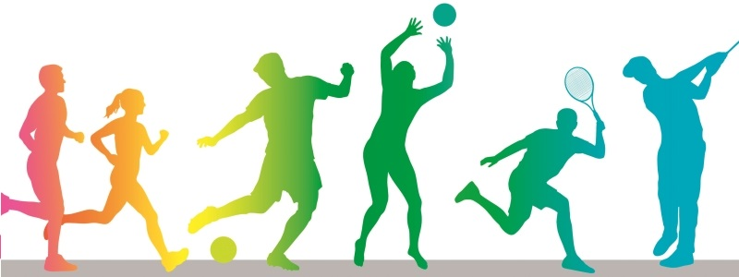
Capstone Project Report: New York County State Types and Physical Inactivity Levels
Renata Bastos Gottgtroy

Slide 2
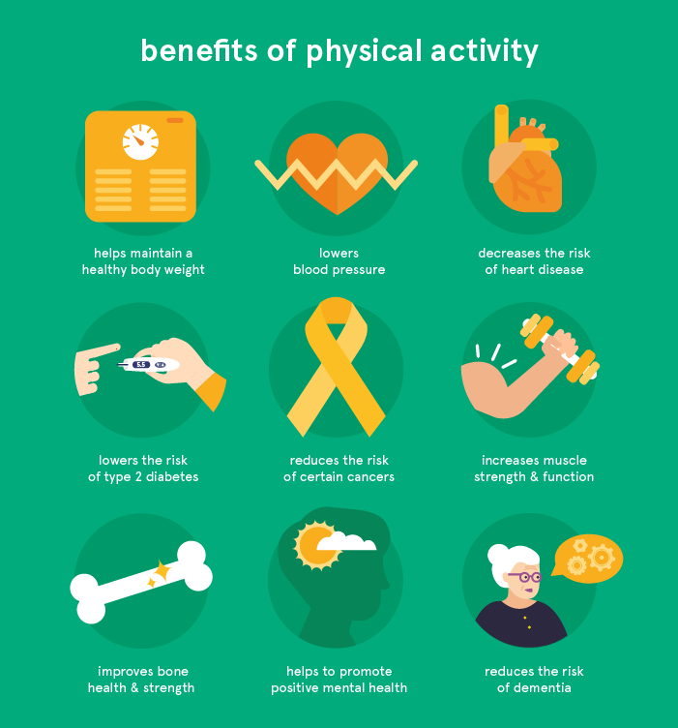
The Importance of Physical Activity
Regular physical activity can have many positive outcomes to the individual.
Physical activity is also beneficial to the society, reducing the costs associated with many diseases.

Slide 3
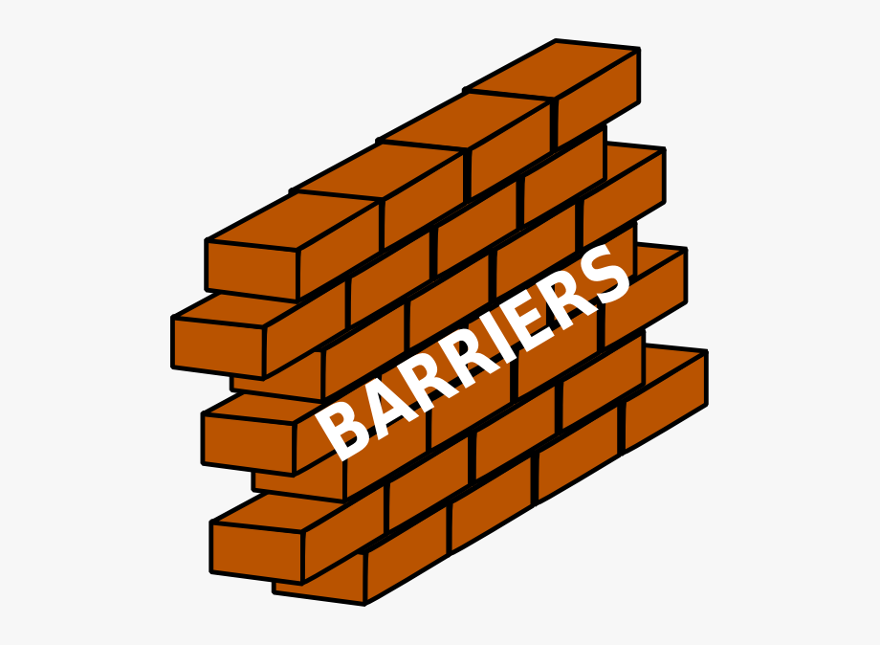
What Predicts Physical Activity?
A common barrier to exercise is access to physical activity friendly spaces.
Other venue categories may discourage physical activity.

Slide 4

Purpose
The aim of this project is to explore if County type (defined by the most common venues in a County) can predict physical activity levels.

Slide 5


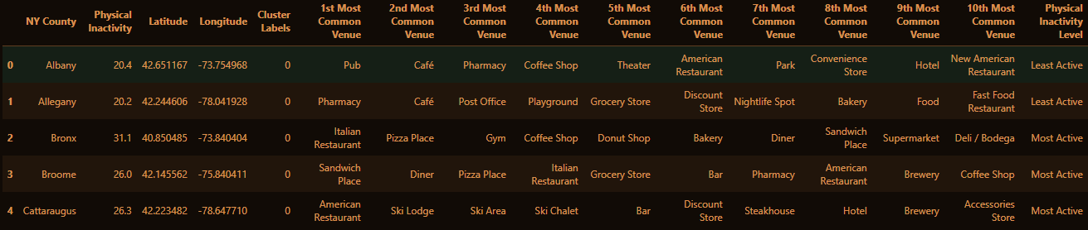
Data
% of physical inactivity by County in the State of New York
Sourced from NYS Health Foundation
Venue categories in each County
Sourced from Foursquare

Slide 6
Methodology
Import, clean and prepare data
Cluster Counties based on the 10 most common venue categories
Kmeans Clustering
Use cluster labels to predict 4 different levels of physical activity
SVM
Decision trees
Evaluate models

Slide 7
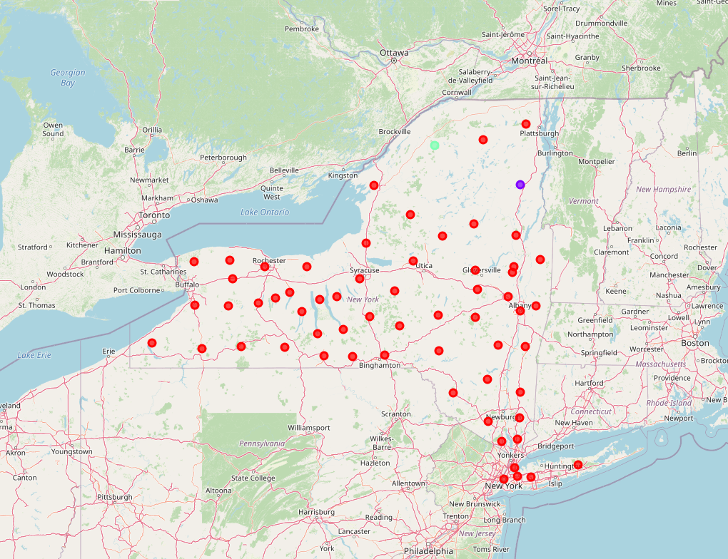
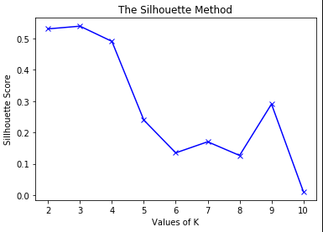
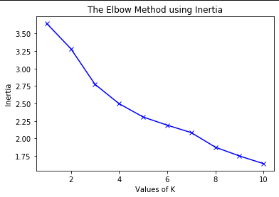
Results
Counties were clustered into 3 clusters
Silhouette score and elbow method were used to select number of clusters

Slide 8
Results: Classification performance
 | Decision Tree | Support Vector Machine
F1 Score | 0.04 | 0.02
Jaccard Similarity Score | 0.04 | 0.02

Slide 9
Discussion and future directions
Conclusion:
County type (defined by most common venue categories) ≠ predict physical activity levels
Discussion:
Poor clustering due to too narrow category definition e.g Indian restaurant vs restaurants.
Limitation of study: Could not extract parent categories of venues which may have resulted in better clustering and prediction
Future research should explore if wider defined category of venues in each county can predict physical activity levels

